Slide 1
LV= Data Science & University of Bristol

Slide 2
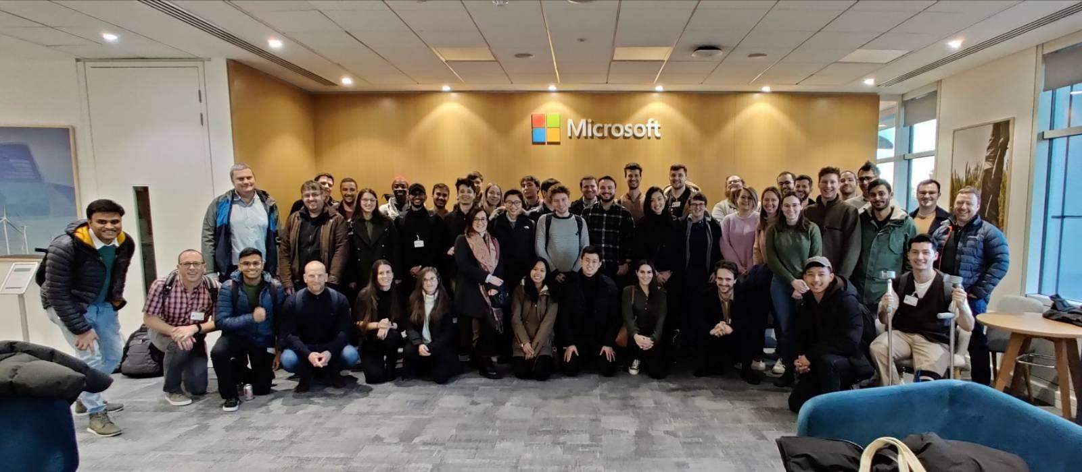

About us
Who are we?
Team of ~60
Cross-site collaboration between Bristol, Bournemouth and London
Variety of backgrounds – computer science,
mathematics, economics, physics, engineering
Our mission
For machine learning to influence every decision within LV=

Slide 3
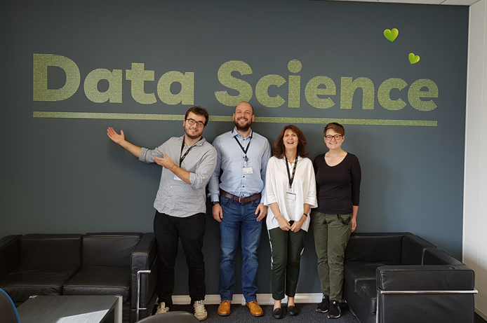
Partnership
Large scale collaboration
BDSS
SCEEM
School of Maths
Compass CDT
BDFI
Jean Golding Institute
Bristol team are based in Merchant Ventures Building

Slide 4
Model Lifecycle
from inception to production

Slide 5
Project roles
Data Scientist
Develops the solution and productionises the model
Shadow Data Scientist & Data Engineer
Reviews the code
Data Engineer
Gathers the data and productionises the model
Business Analyst
Helps to scope the problem - understands the system and data available
Solutions Architect
Helps us to integrate our solution into the business
Stakeholder
Problem owner
End User
Tells us about any pain points

Slide 6



Model Lifecycle Stages
Scoping
Kick off team meeting
Data Extraction
Model Development
Model Evaluation
Productionisation

Slide 7
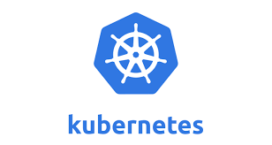
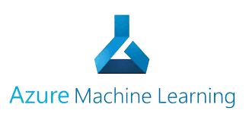

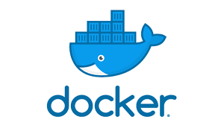


Technology

Slide 8
Recruitment

Slide 9
What we offer
We recruit regularly for graduate data scientists and data engineers.
We also sponsor students to complete their MSc projects with us.
We will be taking on our first placement (year in industry) student in July.
Currently we don’t have any open positions but keep any eye out! https://www.jobs.lv.com/gi/key-teams/data-science

Slide 10
Challenge

Slide 11
The Task
Background
LV= wants to identify fatal/serious casualties early to ensure a quick response is given to those affected.
Further to this, LV= wants to know the most important characteristics of serious casualties to help customers stay safe on the road.
Objective
Predict whether a fatal/serious casualty occurs using road traffic data about the casualty, accident, and vehicles involved.
See README for full instructions

Slide 12

Tubular
Open-source Python package created and maintained by LV=
This challenge has a focus on pre-processing data ready for modelling.
This is an important step in the DS lifecycle yet often overlooked.
Tubular helps with common operations such as capping, imputing, and mapping values.
You may wish to use Tubular but it is not mandatory.
Install from PyPI using pip install tubular
Documentation can be found here: https://tubular.readthedocs.io/en/latest/index.html

Slide 13
Good luck!

